Slide 1
Gradient Descent

Slide 2
Chosing the regression line
Sum the error over m training examples
To simplify calculations
We dont want negative values
Difference between what hypothesis predicted and what the actual value is
Find θ which minimizes the expression

Slide 3
Gradient Descent
Chose initial values of θ₀ and θ₁ and continue moving the direction of steepest descente
J(θ)
θ₀
θ₁

Slide 4
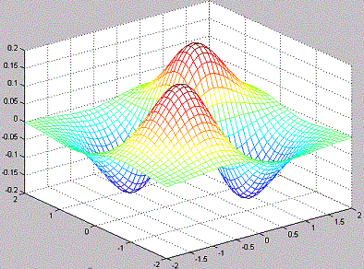
Gradient Descent
Chose initial values of θ₀ and θ₁ and continue moving the direction of steepest descente
The step size is controlled by a parameter called learning rate
Starting point is important

Slide 5
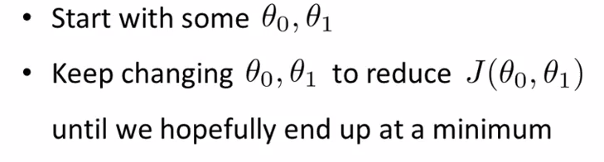

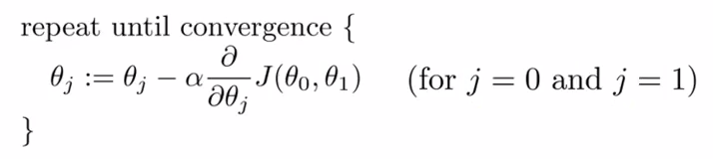
Gradient descent

Slide 6
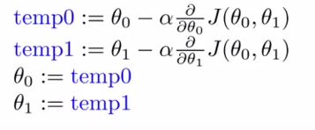
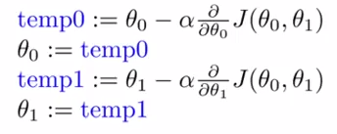
Gradient descent
Simultaneous update of θ₀ and θ_{1 :}
Incorrect:

Slide 7
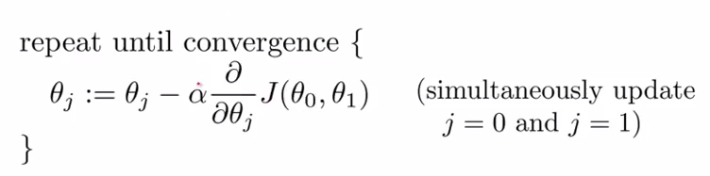
Gradient descent
Step size
Derivative Term
For simplicity, assume we have to minimize a function of one variable only J(θ₁)

Slide 8
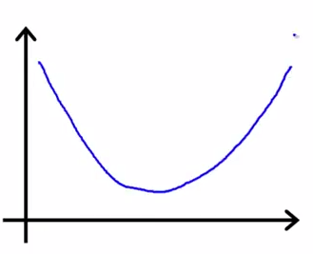
Gradient descent
J(θ₁) ; θ₁ is a real number
J(θ₁)
Slope of the line tangent to the function at point θ₁
θ₁
Initialize θ₁
Line has a positive slope, derivative is positive, so θ₁ moves towards the left

Slide 9
Gradient descent
J(θ₁) ; θ₁ is a real number
J(θ₁)
Slope of the line tangent to the function at point θ₁
θ₁
Line has a positive slope, derivative is positive, so θ₁ moves towards the left

Slide 10
Gradient descent
J(θ₁) ; θ₁ is a real number
J(θ₁)
θ₁
Line has a negative slope, derivative is negative, θ₁ minus a negative number adds something to θ₁ and moves it towards the right

Slide 11
Gradient descent
J(θ₁) ; θ₁ is a real number
J(θ₁)
θ₁
IF alpha is too small, gradient descent will take small steps, hence a long time to converge

Slide 12
Gradient descent
J(θ₁) ; θ₁ is a real number
J(θ₁)
θ₁
IF alpha is too large, gradient descent can overshoot the minimum and may fail to converge

Slide 13
Gradient descent
J(θ₁) ; θ₁ is a real number
J(θ₁)
θ₁
If is θ₁ already at minimum, the derivative term will be zero and the algorithm will converge in the first iteration

Slide 14
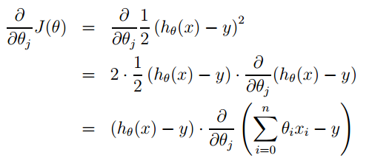
Gradient descent
Simplify: Assume we have only one training example (x, y), so that we can neglect the sum in the definition of J

Slide 15
Gradient descent
All terms are constant except θ_{j}

Slide 16
Gradient descent
For a single training example the update rule becomes:
For multiple training examples:
Repeat Until Convergence{
}
(For every j)

Slide 17
Gradient descent
Batch Gradient Descent
See all training examples for one iteration of gradient descent
Can be costly for larger training sets
Repeat Until Convergence{
}
(For every j)

Slide 18
Gradient descent
Stochastic/Incremental Gradient Descent
Each time we encounter a training example, we update the parameters according to the gradient of the error with respect to that single training example only
Loop{
for i=1 to m {
}
}
(for every j)

Slide 19
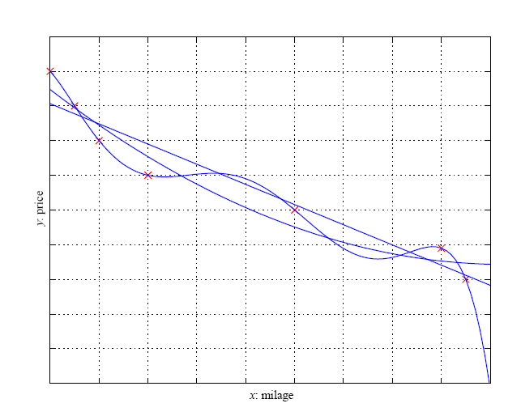
Model Selection
Life is not as simple as Linear
Non-Linear Regression
Higher order polynomial

Slide 20
KNN

Slide 21
Knn classification
Given a training dataset with classes i.e. data and their labels are known
Objective: Decide the class (or label) of a test vector x_{t}
Method:
Compute the distance between the vector x_{t} and all examples of the training dataset
Decision: assign the class of the nearest neighbor (closest point) from training dataset to the vector x_{t}

Slide 22
knn classification
x_{t}
Feature Space
Vectors of the blue
class
Vectors of the red
class
Class (x_{t})
=
Class of the nearest neighbor

Slide 23
K-Nearest Neighbor Rule
Given a training dataset with classes i.e. data and their labels are known
Objective: Decide the class (or label) of a test vector x_{t}
Method:
Compute the distances between the vector x_{t} and all examples of the training dataset
Determine k nearest neighbors of x_{t}
Decision: class(x_{t}) = majority vote of k nearest neighbors
The choice of distance is very important

Slide 24
K-Nearest Neighbor Rule
Example
Class 1
Class 1
Class 2
Class 2
1-NN
3-NN

Slide 25
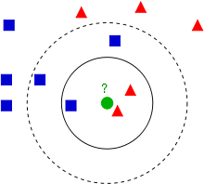
K-Nearest Neighbor Rule
The test sample (green circle) should be classified either to the first class of blue squares or to the second class of red triangles. If k = 3 it is assigned to the second class because there are 2 triangles and only 1 square inside the inner circle. If k = 5 it is assigned to the first class (3 squares vs. 2 triangles inside the outer circle).
Image Source: Wikipedia

Slide 26
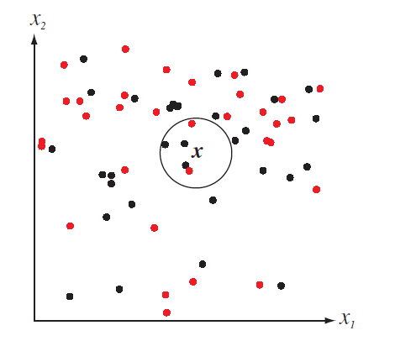
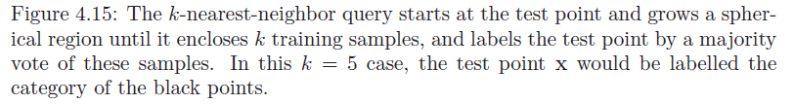

Slide 27
Distance Metric
A distance metric D(.,.) is merely a function that gives generalized distance between two patterns
For three vectors a, b and c, a distance metric should hold following properties
Non-negativity:
Reflexivity:
Symmetry:
Triangle inequality:

Slide 28
Distance Metric
Euclidean distance possesses all the four properties
Euclidean distance
in d-dimensions

Slide 29
Distance Metric
Data normalization
If there is a large disparity in the ranges of the full data in each dimension, a common procedure is to rescale all the data to equalize such ranges
Euclidean distance is frequently employed as the distance metric in nearest neighbor classifier

Slide 30
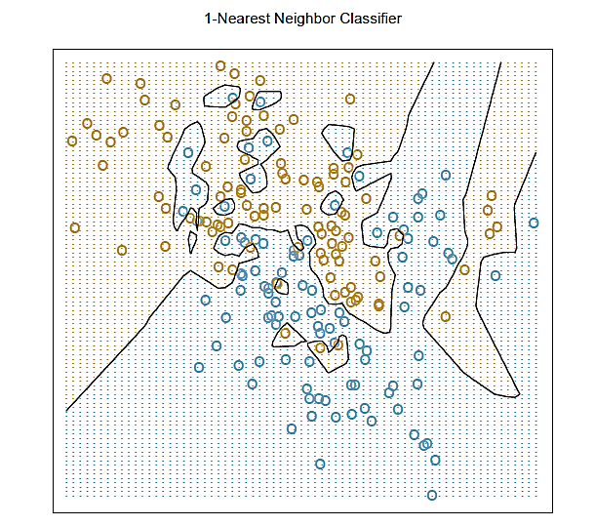
k-Nearest Neighbor Classifier Example:
k =1
Decision boundary is complex

Slide 31
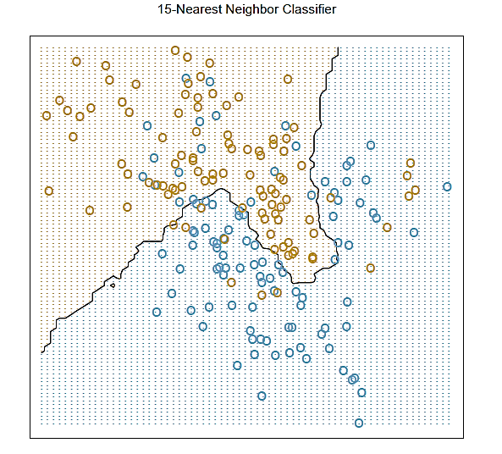
k-Nearest Neighbor Classifier Example:
k =15
Decision boundary is relatively simple

Slide 32
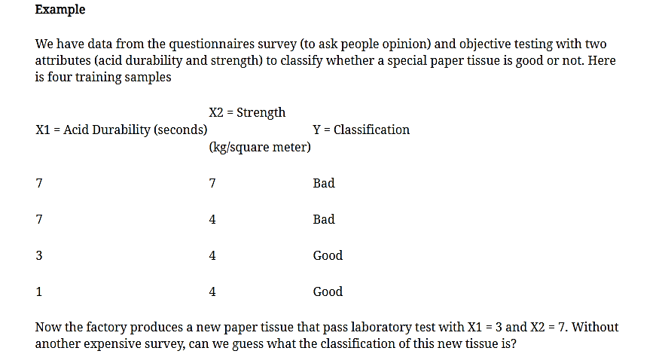

Slide 33
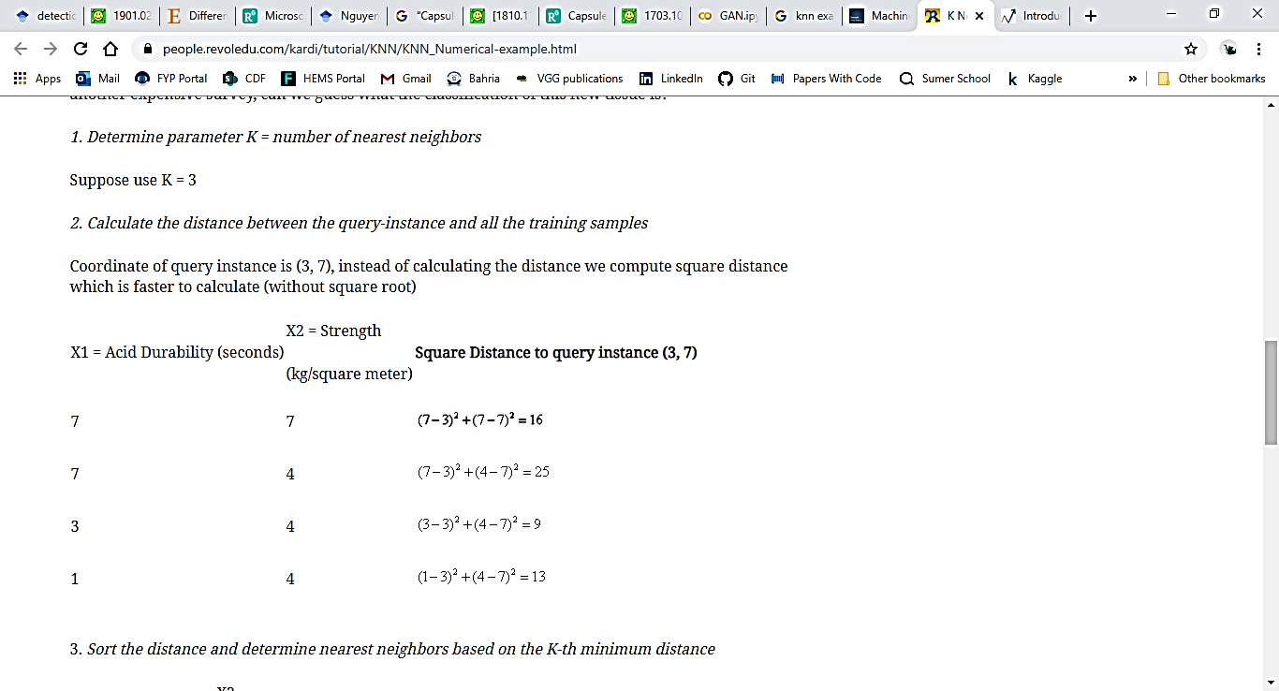

Slide 34
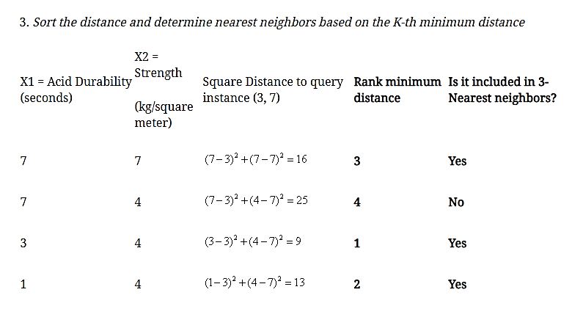

Slide 35
